Slide 1
Title Slide
Project Name: GSM Based Fire Alert System
Name: Thirumalagiri Amulya
Intern ID:CITS3856
Duration: 4 Weeks

Slide 2
Abstract
The GSM-Based Fire Alert System is an embedded safety system designed to detect fire hazards and immediately notify users through mobile communication. It mainly uses sensors like a temperature sensor (LM35) or smoke sensor (MQ-2/MQ-135) to continuously monitor the environment. When the sensor detects abnormal heat or smoke levels beyond a set threshold, the microcontroller (such as Arduino or PIC) processes the signal and activates a buzzer or alarm for local warning.
At the same time, a GSM module (like SIM800L or SIM900) is used to send an SMS alert to the registered mobile number, informing the user about the fire incident and location details if programmed. This allows real-time remote monitoring and quick response even when the user is not physically present.
The system is low cost, easy to implement, and highly reliable for homes, offices, schools, and industries. It helps in reducing fire damage by ensuring early detection and immediate communication. The project is widely used in IoT and embedded systems applications for smart safety and automation solutions.

Slide 3
Introduction
The GSM-Based Fire Alert System is an embedded safety system designed to detect fire accidents at an early stage and send immediate alerts to users through mobile communication. Fire accidents can cause major loss of life and property, so early detection is very important in homes, offices, and industries.
This system uses sensors such as a smoke sensor (MQ series) or temperature sensor (LM35) to continuously monitor environmental conditions. When the sensor detects abnormal smoke or a sudden rise in temperature, the microcontroller processes the signal and triggers an alarm for local warning.
Along with the alarm, a GSM module like SIM800 or SIM900 sends an SMS alert to the registered mobile number, informing the user about the fire situation. This enables quick response even when the user is far away from the location.
The system is simple, low-cost, and reliable, making it suitable for real-time fire monitoring and protection in various applications.

Slide 4
Objectives
The main objective of the GSM-Based Fire Alert System is to detect fire or smoke at an early stage using sensors such as MQ-2 smoke sensor or temperature sensors like LM35. When abnormal conditions are detected, the system immediately activates an alarm or buzzer to provide local warning and simultaneously sends an SMS alert to the user through a GSM module. This helps in informing the user even when they are not present at the location. The system is designed to reduce damage to life and property by ensuring quick response during fire accidents. It aims to provide a low-cost, reliable, and efficient fire safety solution for homes, offices, and industrial environments.

Slide 5
Components Used
1. Arduino Uno 2. GSM Module (SIM800L/SIM900) 3. Smoke Sensor (MQ-2) 4. Temperature Sensor (LM35) 5. Buzzer 6. SIM CARD 7. Connecting Wires 8. Breadboard 9. LCD Display

Slide 6
Methodology
The methodology of the GSM-Based Fire Alert System involves continuous monitoring, detection, and alert transmission. First, the system is powered using a regulated power supply, which provides stable voltage to all components. A temperature or fire sensor (such as LM35 or flame sensor) continuously monitors the surrounding environment for abnormal heat or flame presence. The sensor output is given to a microcontroller (like Arduino or PIC), which processes the signal and compares it with a predefined threshold value. If the temperature exceeds the limit or fire is detected, the microcontroller immediately activates the alert system. At the same time, a GSM module (such as SIM800L or SIM900) is triggered to send an SMS alert or call to the registered mobile number. Additionally, a buzzer or alarm may also be activated locally to warn nearby people. This process ensures real-time fire detection and instant notification to prevent major damage.

Slide 7
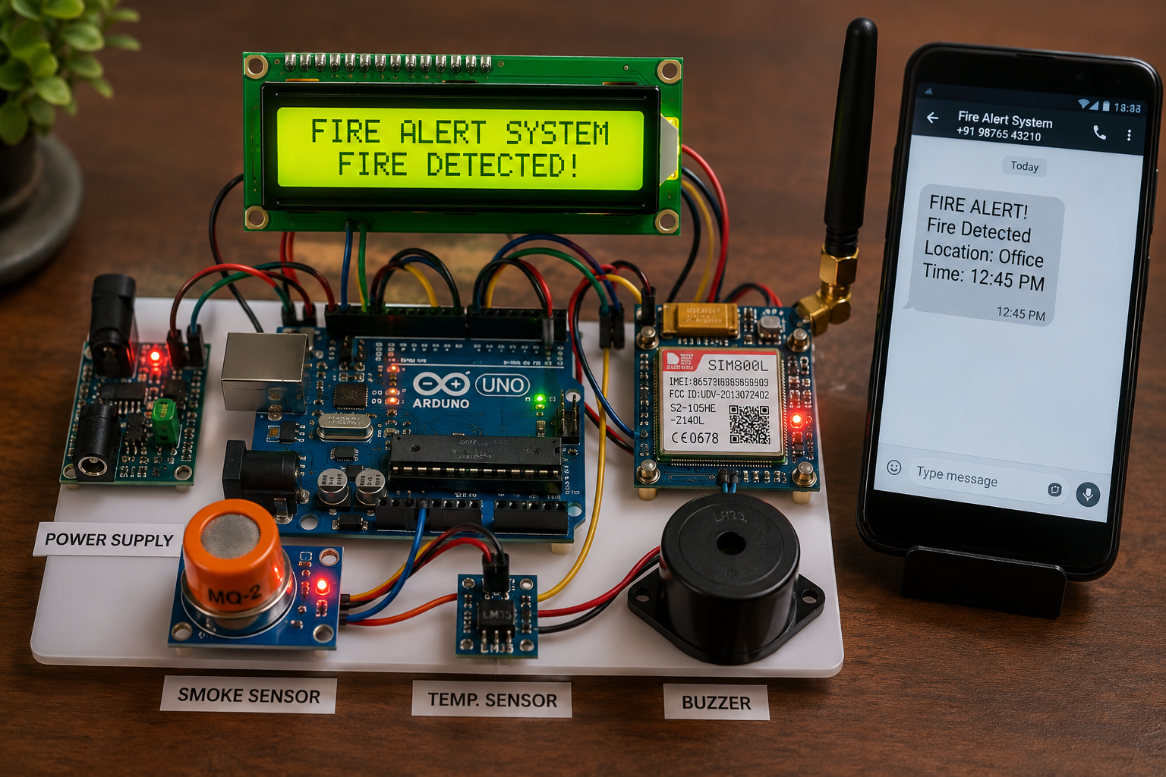
Result
The GSM-Based Fire Alert System successfully detects abnormal temperature rise or fire using the sensor and immediately processes the signal through the microcontroller. When the threshold value is exceeded, the system activates a buzzer alarm for local warning and simultaneously sends an SMS alert to the registered mobile number through the GSM module. The response is fast and reliable, ensuring real-time notification of fire incidents. This helps in taking quick action to prevent damage to life and property. The system operates continuously and provides effective monitoring of the surrounding environment.

Slide 8
ADVANTAGES
Early Detection
Instant Alerts
Remote Monitoring
Low Cost
Easy Installation
Safety
Accuracy
Efficiency
Security

Slide 9
APPLICATIONS
Petrol Stations
Shopping Malls
Hospitals
Schools
Colleges
Banks
Factories
Agricultural Storage Units
Homes
Hotels

Slide 10
CONCLUSION
The GSM-Based Fire Alert System is an effective and safety solution that detects fire hazards using smoke and temperature sensors. When a fire is detected, the system immediately sends an alert message through the GSM module and activates a buzzer for warning. This helps in taking quick action to prevent damage to life and property. The system is low-cost, easy to implement, and suitable for homes industries and other public places

